Slide 1
mechanical stress calculation of the motorcycle rear frame
EX-EF-1

Slide 2
Abstract
The project's aim is to find dynamic implicit FEM stresses in the motorcycle rear frame using experimental fatigue testing.
Other main goals of the thesis include analyzing the critical stress areas in the rear-frame and improving the computation time efficiency.
The simulation will be validated using the Experimental method.
Tasks:
Preparation of time displacement signal based on SWITI experiment
FEM Calculation with abaqus and applying time displacement signal and calculate Mechanical stress
Validation of the FEM with experimental method (via Acceleration and DMS sensors)

Slide 3
PREPARATION OF TIME DISPLACEMENT SIGNAL BASED ON SWITI EXPERIMENT
Short time Fourier Transform & Fast Fourier Transform
Fast Fourier Transform:
Computes DFT (Discrete Fourier Transform) of a sequence
Converts signal from original domain to frequency domain
DFT→ Sequence of values into components of different frequency
Limitations: Lack of temporal resolution
Solution: Time Frequency Analysis (Short time Fourier Transform)
Characterizing and manipulating signals whose statistics vary in time

Slide 4
PREPARATION OF TIME DISPLACEMENT SIGNAL BASED ON SWITI EXPERIMENT
Short time Fourier Transform:
Fourier related Transform → determine frequency and phase content of local sections of a signal as it vary with time
Longer signal → Shorter segment of equal length & compute FT separately
Fourier spectrum on each segment
Plot: Spectrogram (Changing spectra as a function of time)
Illustration of short-time Fourier transform on the test signal x(t) (R.X. Gao and R. Yan)

Slide 5
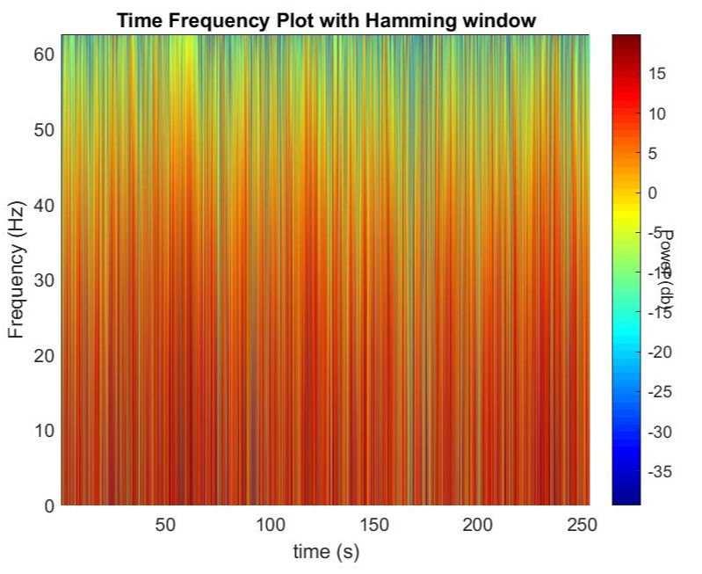
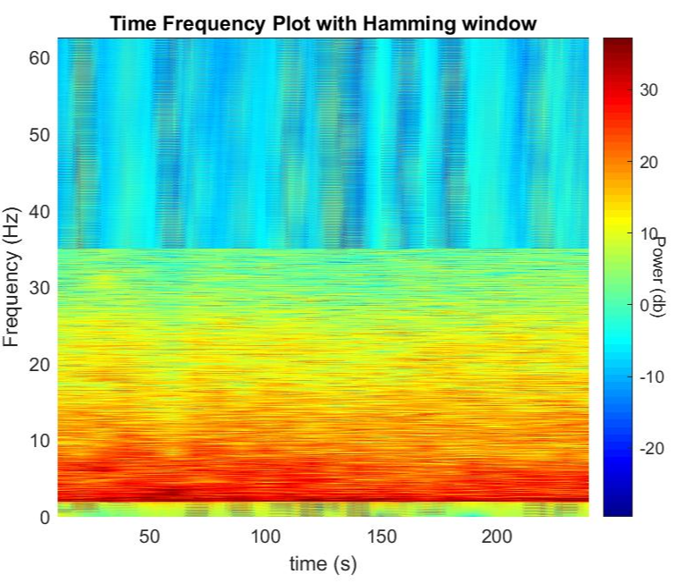
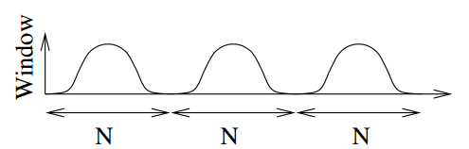
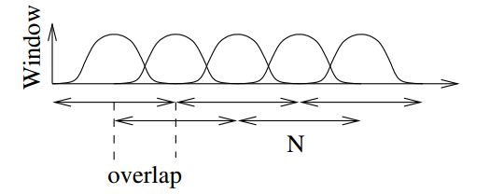
PREPARATION OF TIME DISPLACEMENT SIGNAL BASED ON SWITI EXPERIMENT
Window:
minimize the effect of leakage
Small window size→ Time resolution
Larger window size→ Frequency resolution
Mathematical function symmetric around the middle, maximum in the middle, tapering away from middle
Blackman, Hamming, Gaussian, Rectangular, Kaiser
Overlap:
usually 50% of window length
Tapering function → zero at boundaries

Slide 6
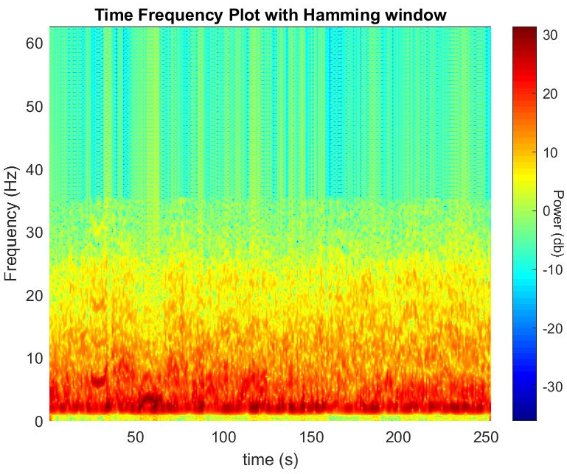
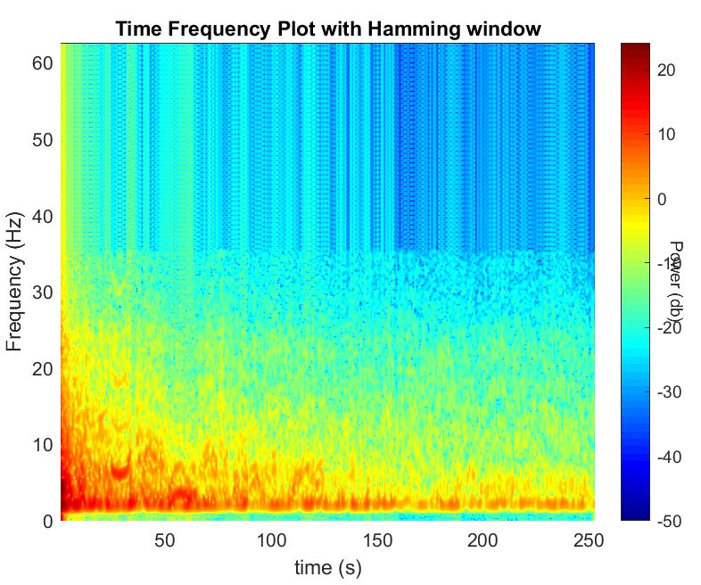
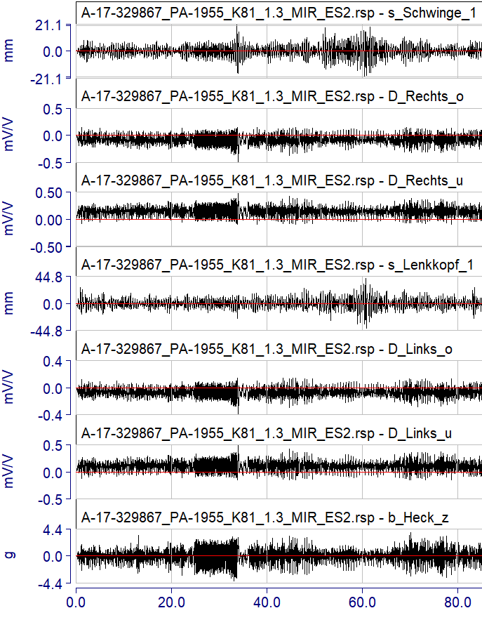
PREPARATION OF TIME DISPLACEMENT SIGNAL BASED ON SWITI EXPERIMENT
Schwinge_1
Displacement of Schwinge_1 all data points
Velocity of Schwinge_1 all data points
Time displacement Experiment data

Slide 7
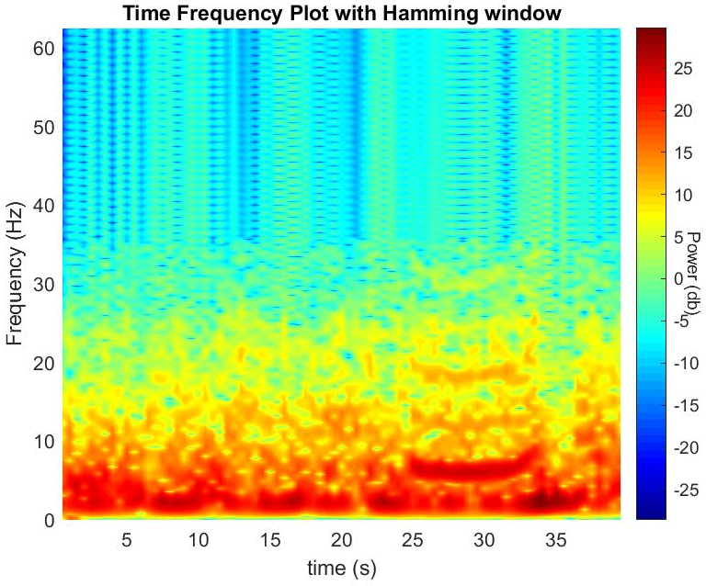
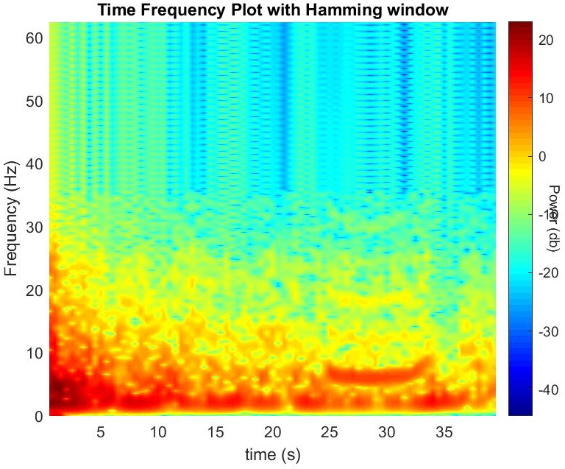
PREPARATION OF TIME DISPLACEMENT SIGNAL BASED ON SWITI EXPERIMENT
Schwinge_1
Displacement of Schwinge_1 (0-40s)
Velocity of Schwinge_1 (0-40s)
Time displacement Experiment data

Slide 8
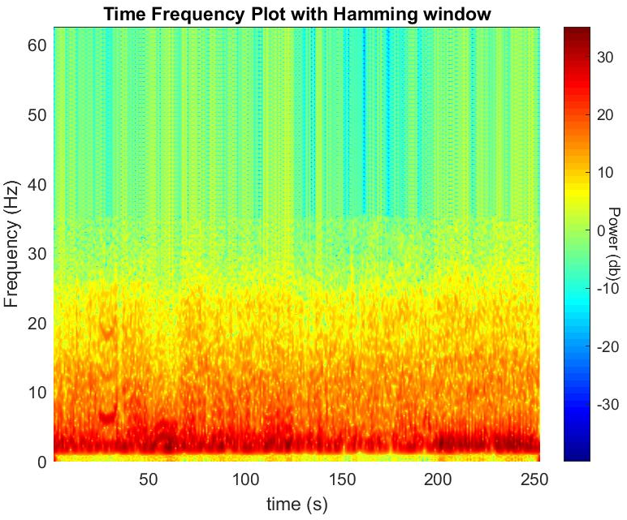
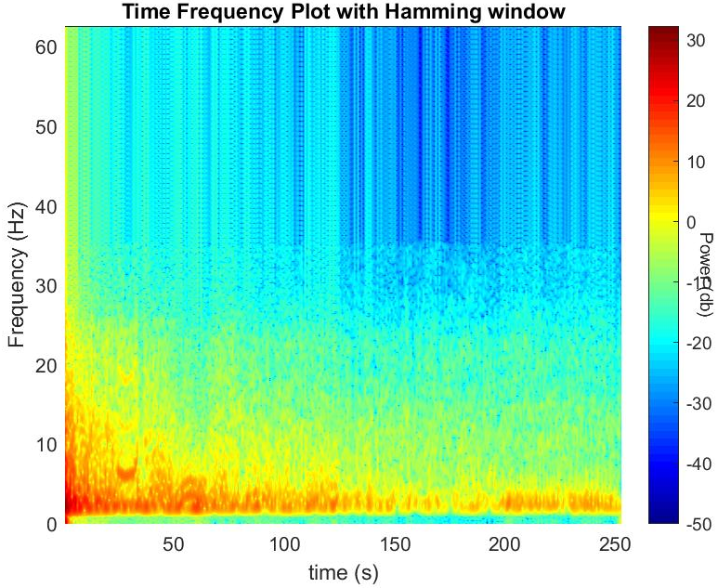
PREPARATION OF TIME DISPLACEMENT SIGNAL BASED ON SWITI EXPERIMENT
Lenkkopf_1
Displacement of Lenkkopf_1 all data points
Velocity of Lenkkopf_1 all data points
Time displacement Experiment data

Slide 9
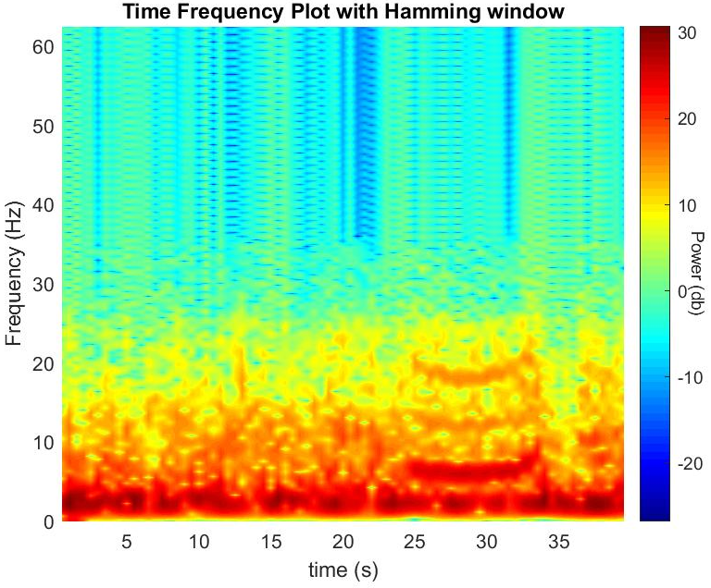
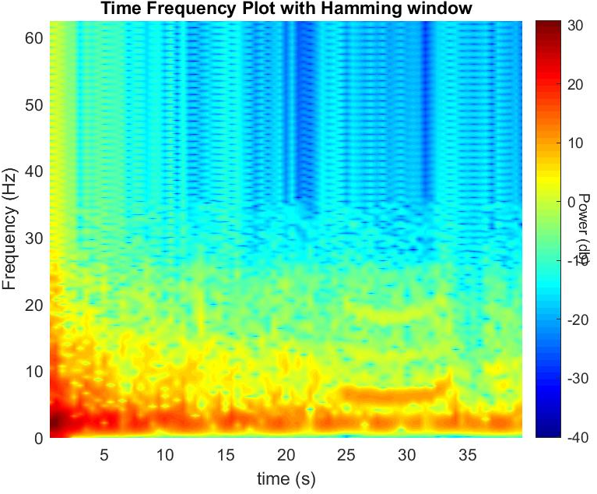
PREPARATION OF TIME DISPLACEMENT SIGNAL BASED ON SWITI EXPERIMENT
Lenkkopf_1
Displacement of Lenkkopf_1 (0-40s)
Velocity of Lenkkopf_1 (0-40s)
Time displacement Experiment data

Slide 10
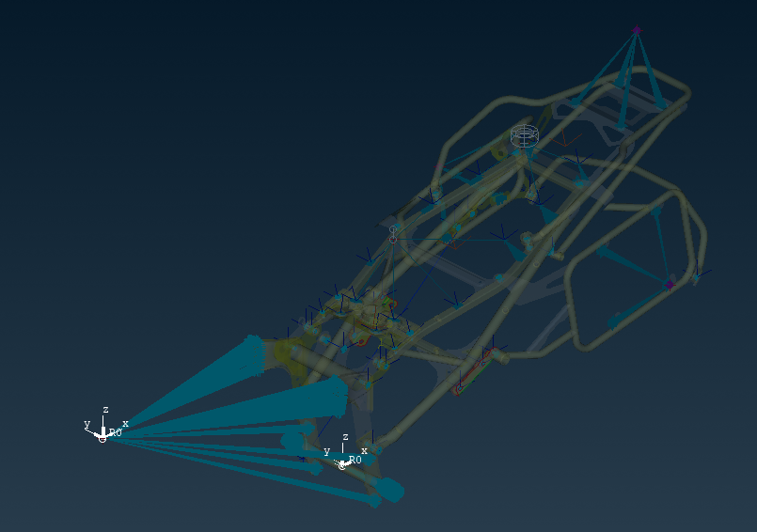
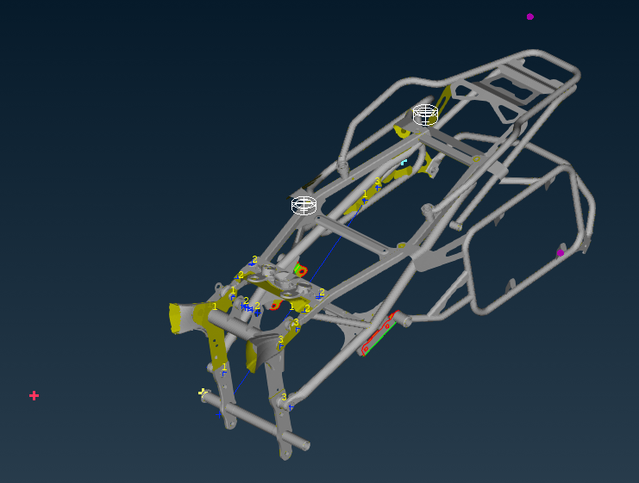
FEM Calculation with abaqus and applying time displacement signal and calculate Mechanical stress
Time displacement Signal:
  Critical points on the time-frequency graph where the spectral power density is high were extracted.
  The Schwinge 1 and Lenkkopf 1 signals are extracted at 34s, 61s, 62s, and 202s based on the maximum power density.
  Initial FEM model was prepared by BMW and then Signals are applied to Lenkkopf and Schwinge as load as mentioned in Figure 1 , and spatial accelerations are computed at the points mentioned in Figure 2.
3
1
1
2
2
Figure 1. Time-displacement signal loading points at: 1. Lenkkopf and 2. Schwinge
Figure 2. Spatial acceleration calculation points at: 1. Lenkkopf, 2. Schwinge and 3. Heckrahmen

Slide 11
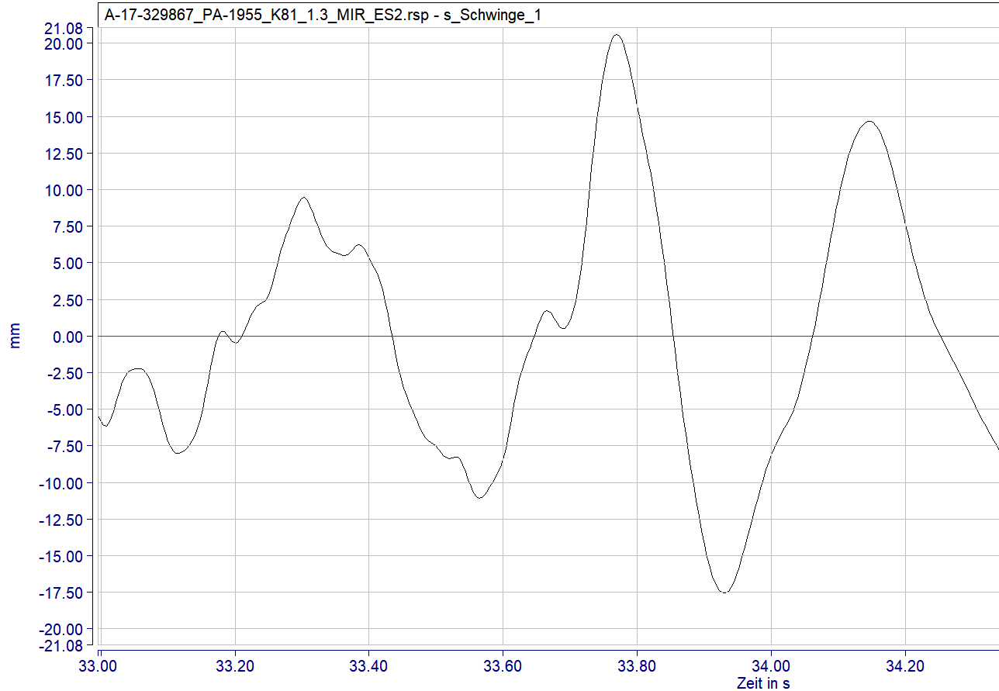
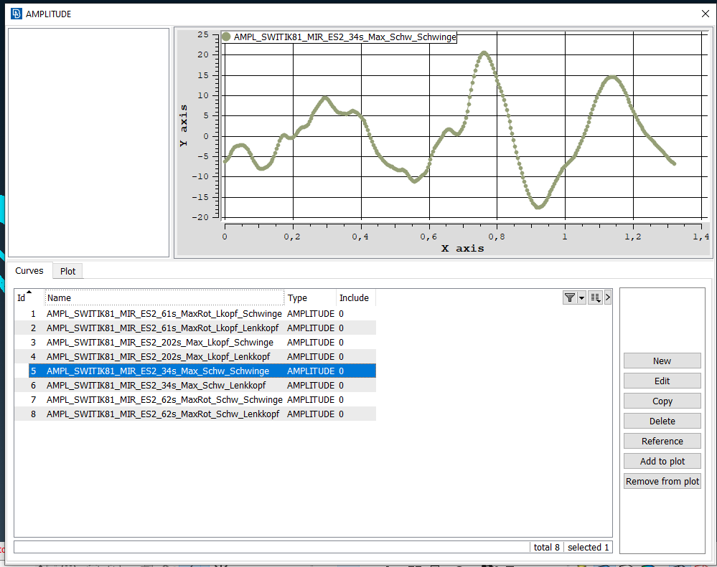
FEM Calculation with abaqus and applying time displacement signal and calculate Mechanical stress
Time displacement Signal:
  Extracted time displacement signal introduced through Amplitude curve
  Similarly all the extacted Schwinge_1 and Lenkkopf_1 time displacement signals are added as load
Time-displacement signal of Schwinge_1 from SWITI experiment
Time-displacement signal of Schwinge_1 in Amplitude curve

Slide 12
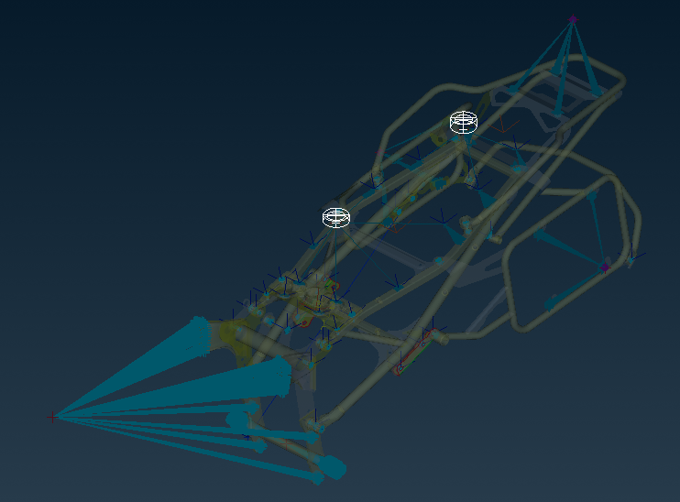
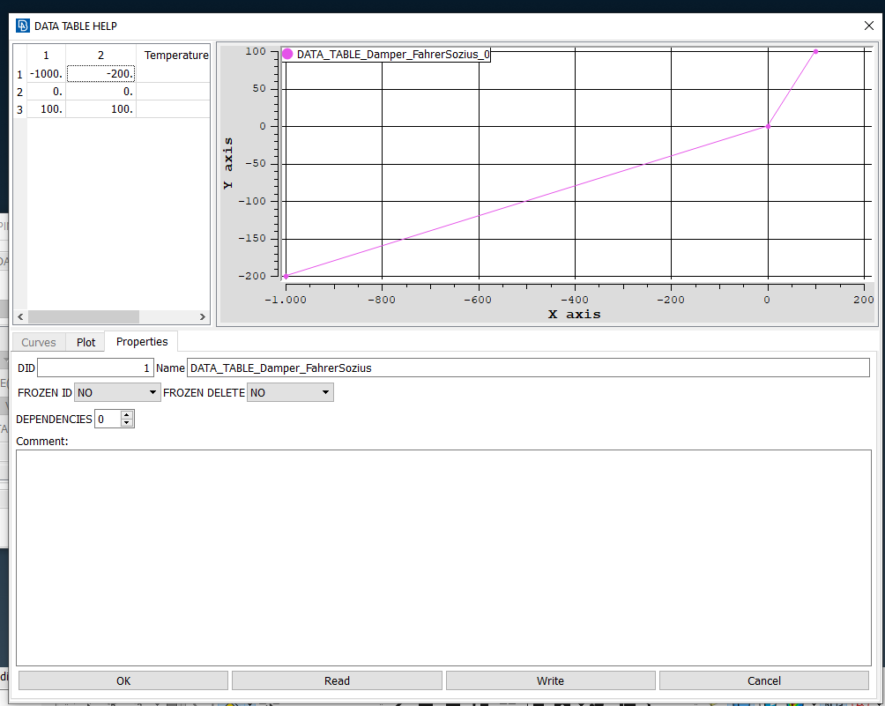
FEM Calculation with abaqus and applying time displacement signal and calculate Mechanical stress
Spring Damper System
  Spring and damper behaviour is transferred from already existing model in driver and Rear seat with a non-linear elasticity and damping with axial connector behavior
Connector behaviour at driver and Rear seat

Slide 13
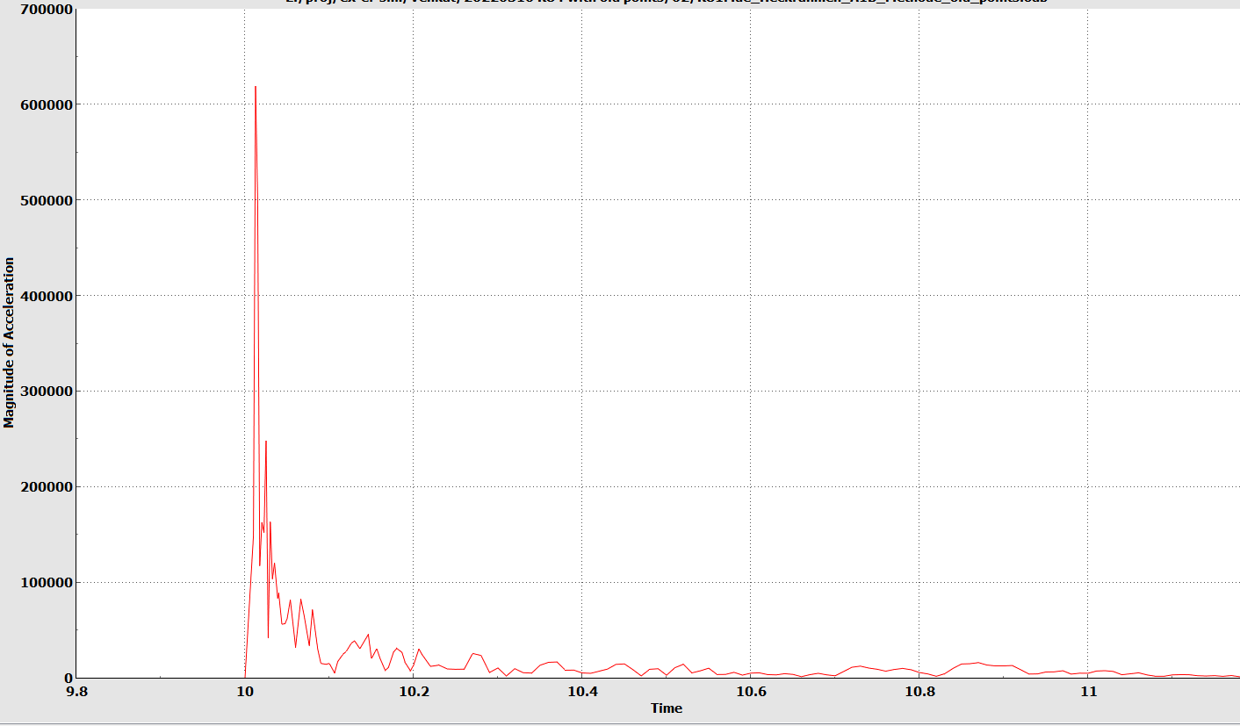
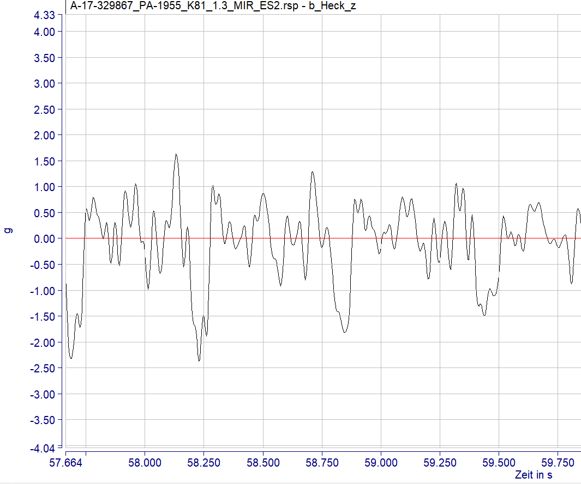
Validation of the FEM with experimental method (via Acceleration and DMS sensors)
  Validation of spatial accelerations at Heckrahmen ís compared with SWITI experiment results for all the input signal (Lenkkopf and Swinge)
Magnitude of Acceleration at Heckrahmen in Abaqus
Magnitude of Acceleration at Heckrahmen in SWITI experiment

Slide 14
Tasks to be done:
  Critical time displacement signal extraction
  Validation of the FEM calculation with the previous model (Validation via Acceleration and DMS sensors)
  Damage and Strength estimation

